Slide 1

CSE 3521: Introduction to Artificial Intelligence
[Many slides are adapted from the UC Berkeley. CS188 Intro to AI at UC Berkeley and previous CSE 3521 course at OSU.]

Slide 2
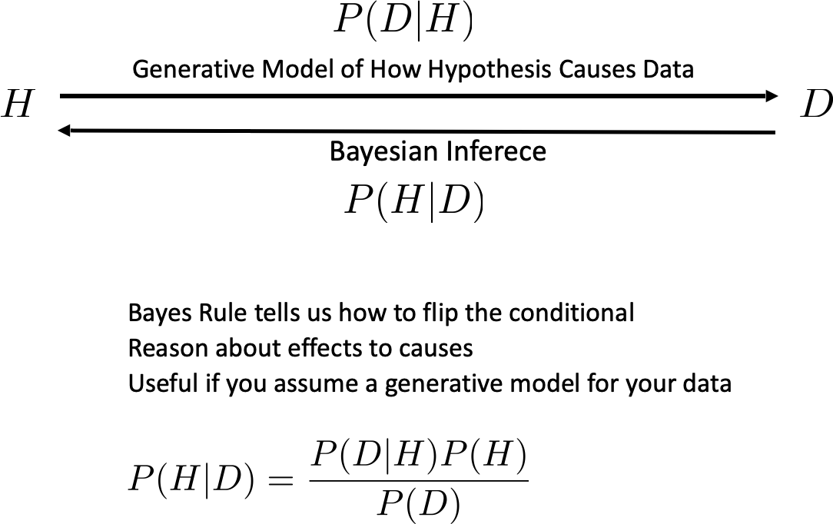
Bayes Rules
Hypothesis
(unknown)
Data
(Observed)

Slide 3
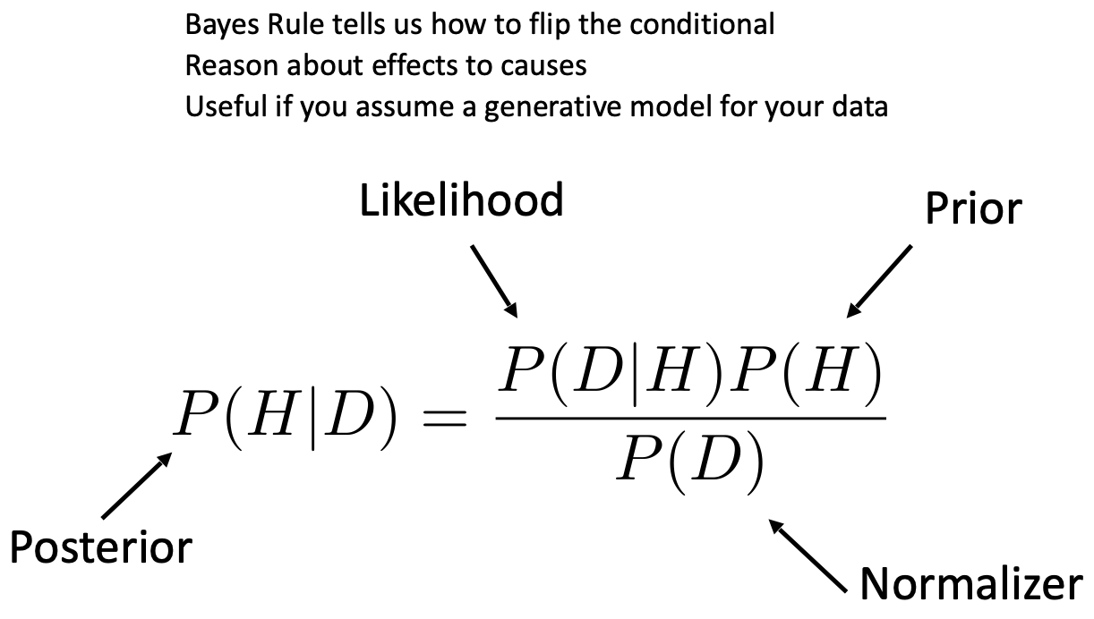
Bayes Rules

Slide 4
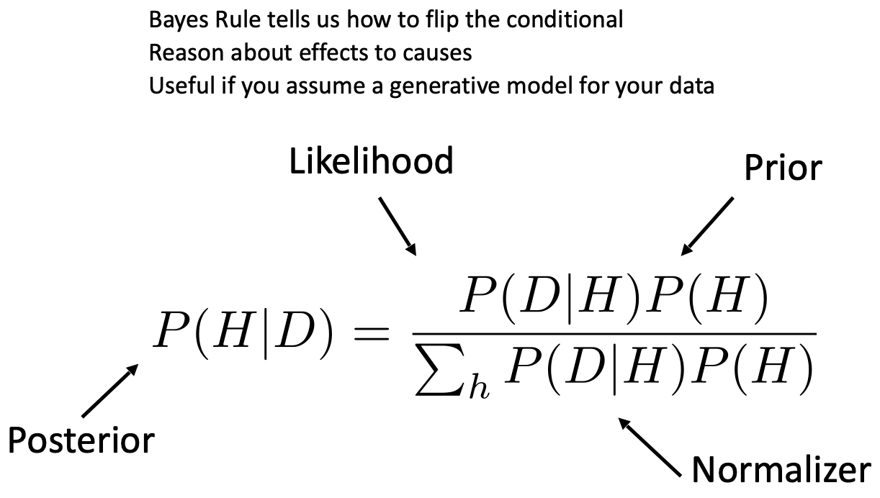
Bayes Rules

Slide 5
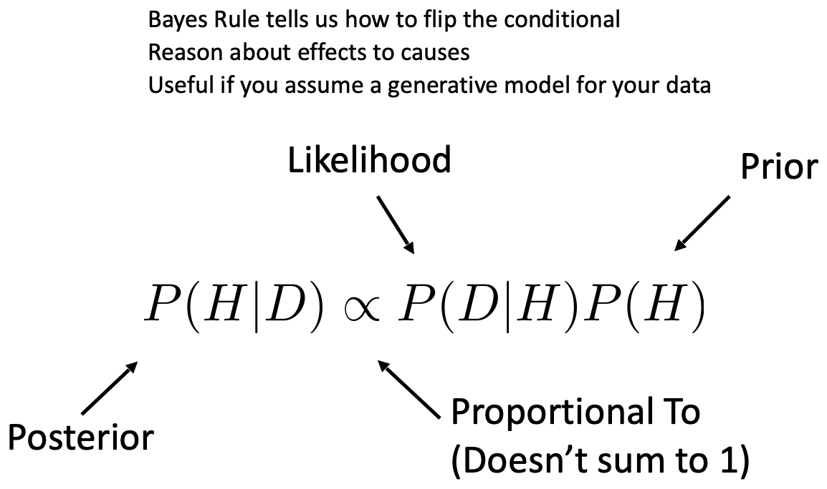
Bayes Rules

Slide 6
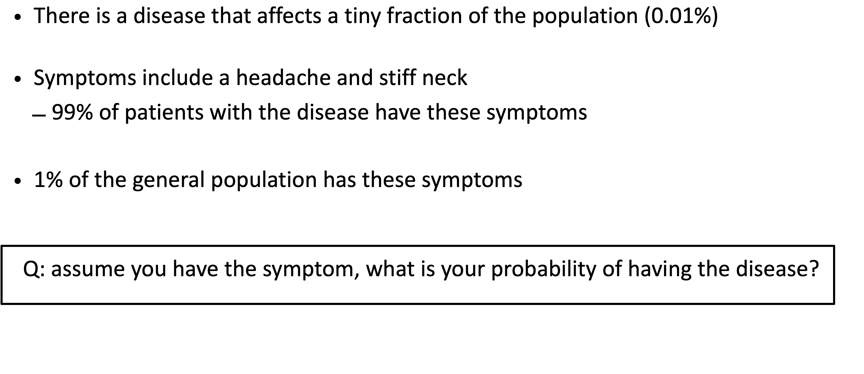
Bayes Rules

Slide 7
Bayes Rules Examples

Slide 8
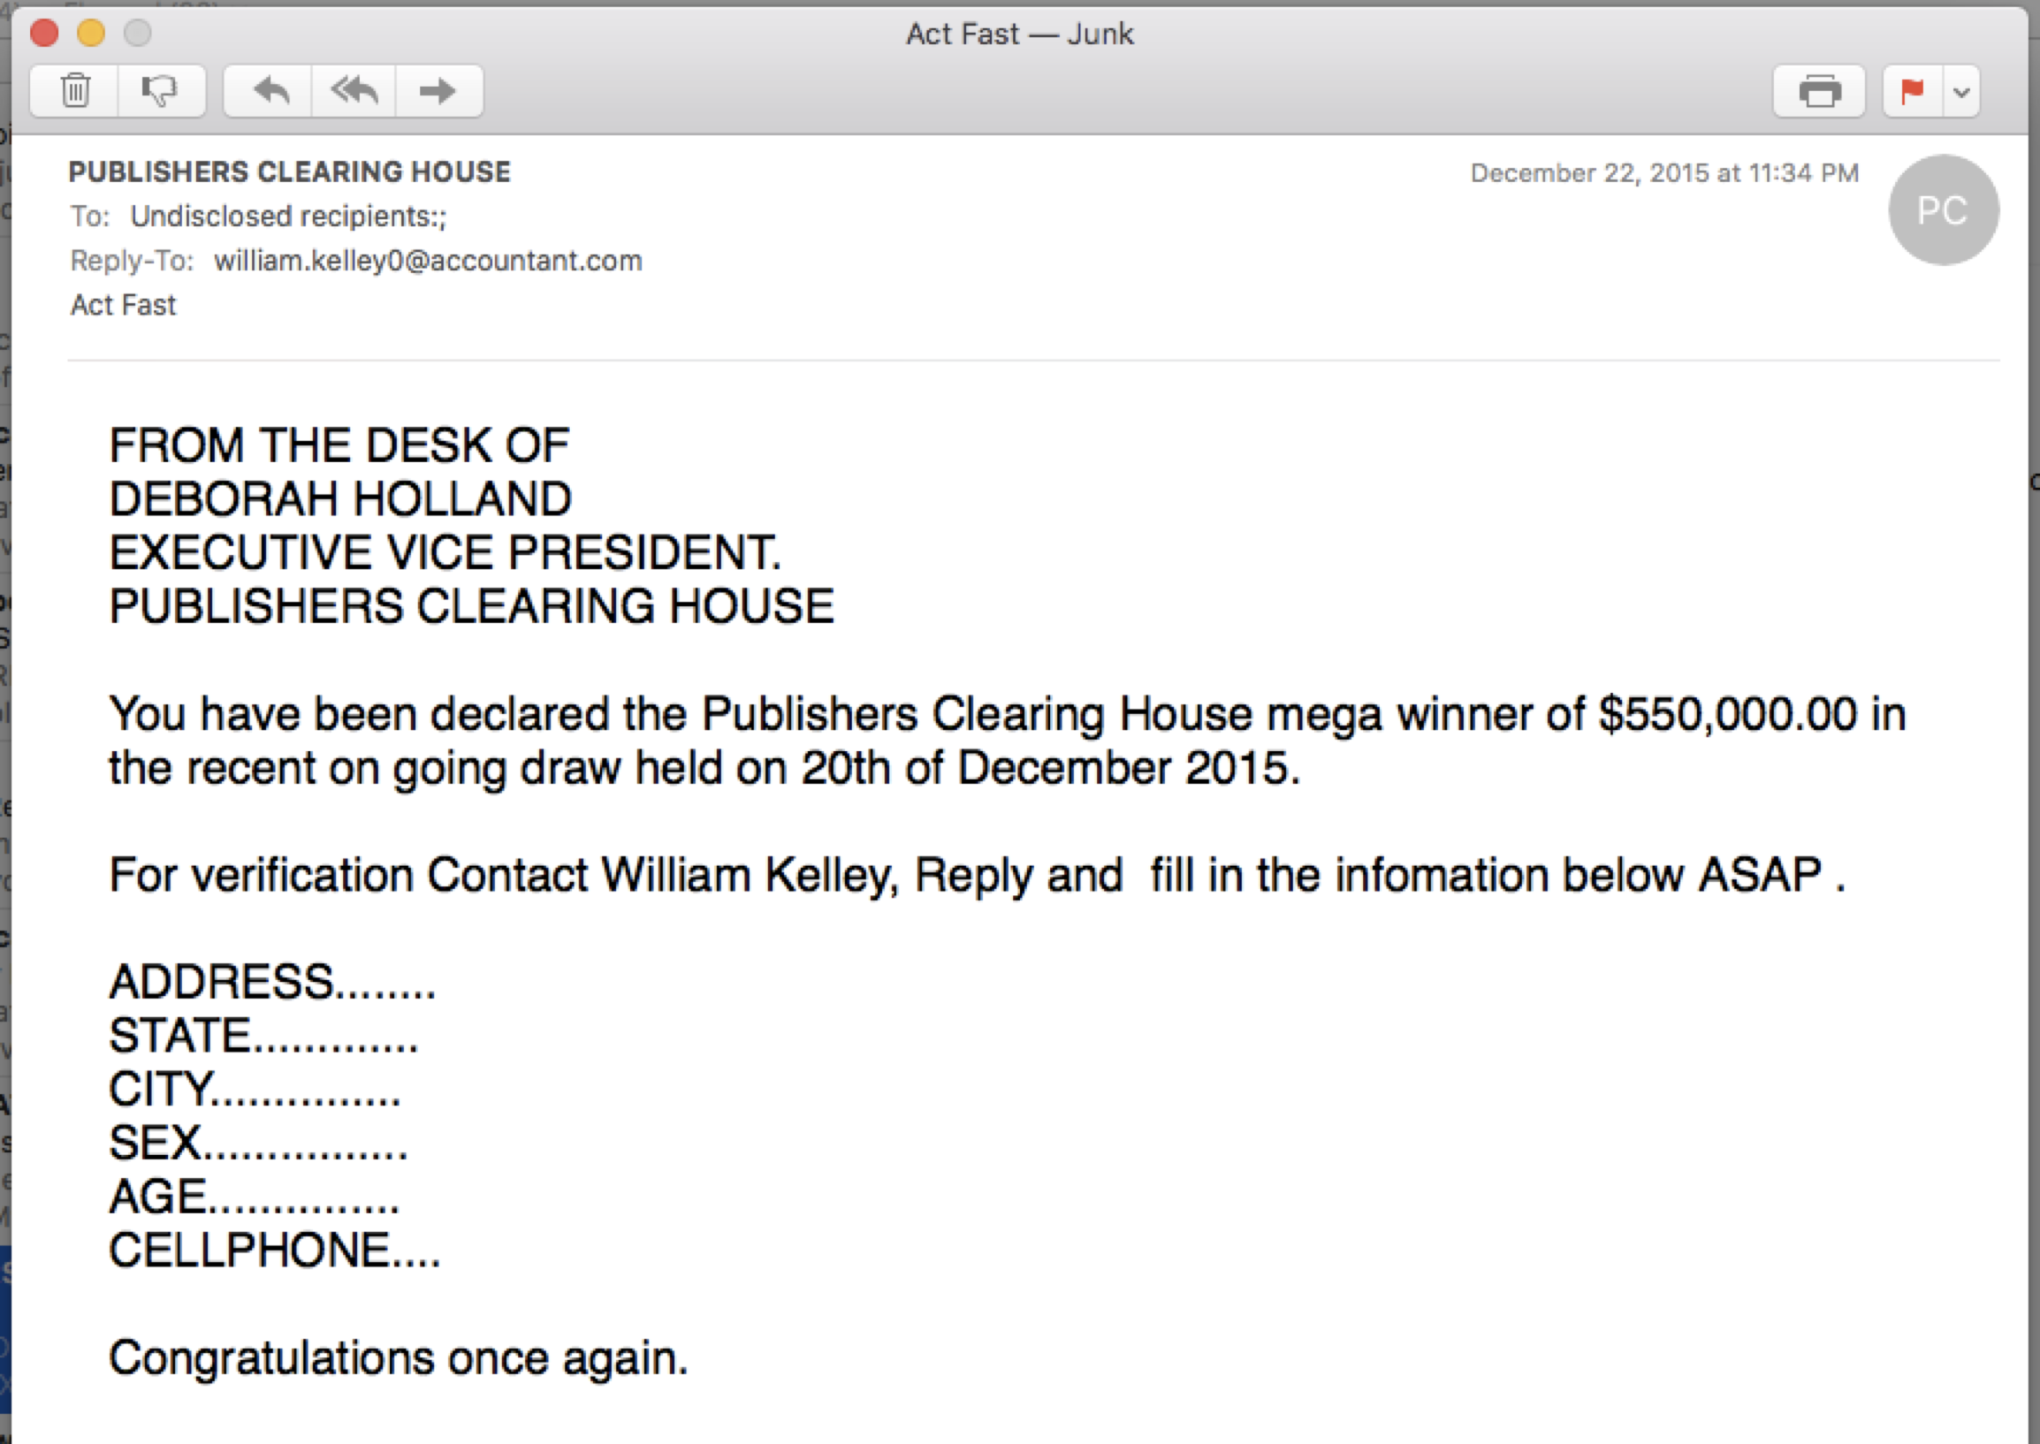
Is this Spam?

Slide 9
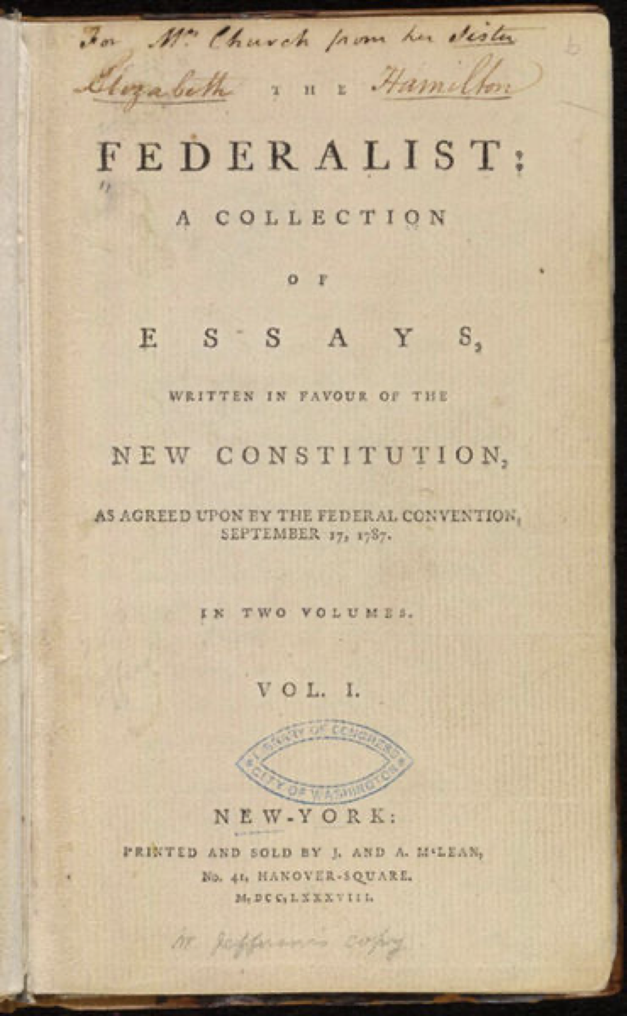
Who wrote this paper?
1787-88: anonymous essays try to convince New York to ratify U.S Constitution.
Authorship of 12 of the letters in dispute
1963: solved by Mosteller and Wallace using Bayesian methods

Slide 10
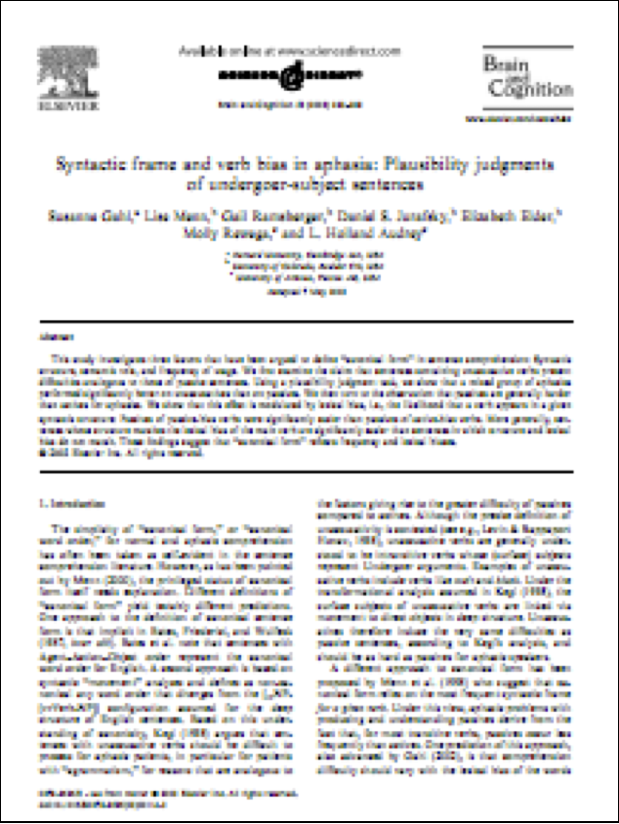
What is the subject of this article
MEDLINE Article
MeSH Subject Category Hierarchy
Antogonists and Inhibitors
Blood Supply
Chemistry
Drug Therapy
Embryology
Epidemiology
…

Slide 11
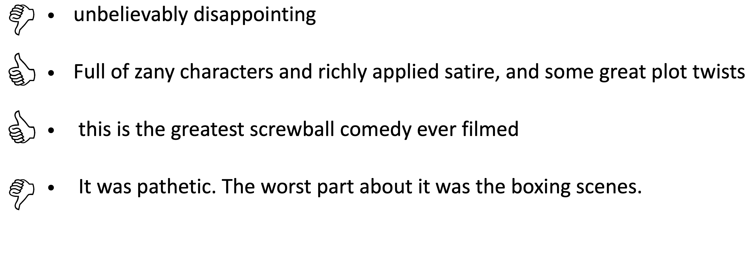
Positive or Negative Review?

Slide 12
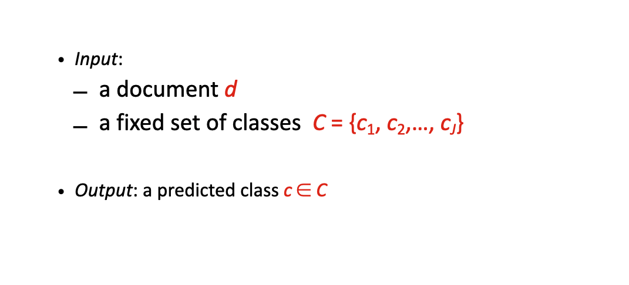
Classification Definition

Slide 13
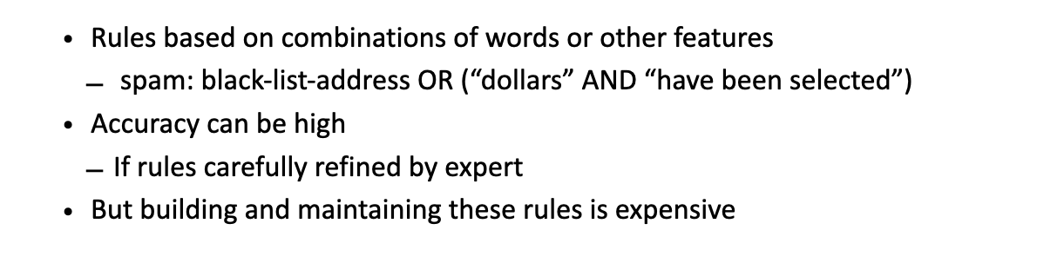
Classification Method: Rules

Slide 14
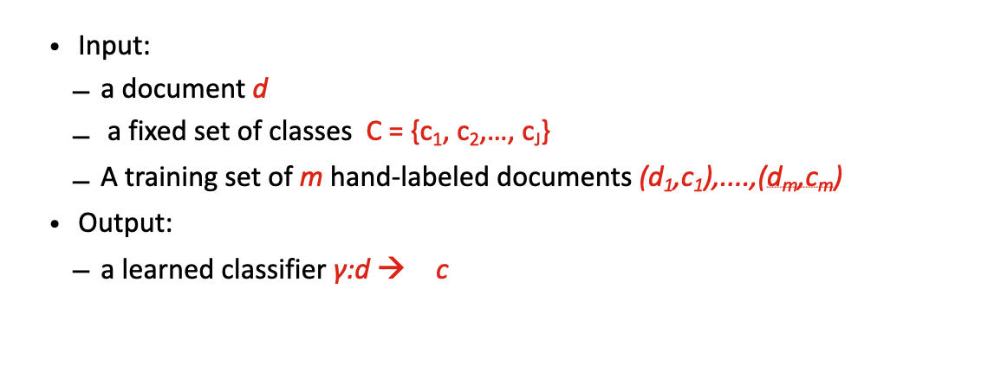
Classification Method: Supervised Learning

Slide 15
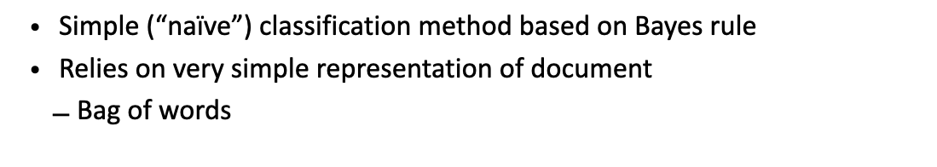
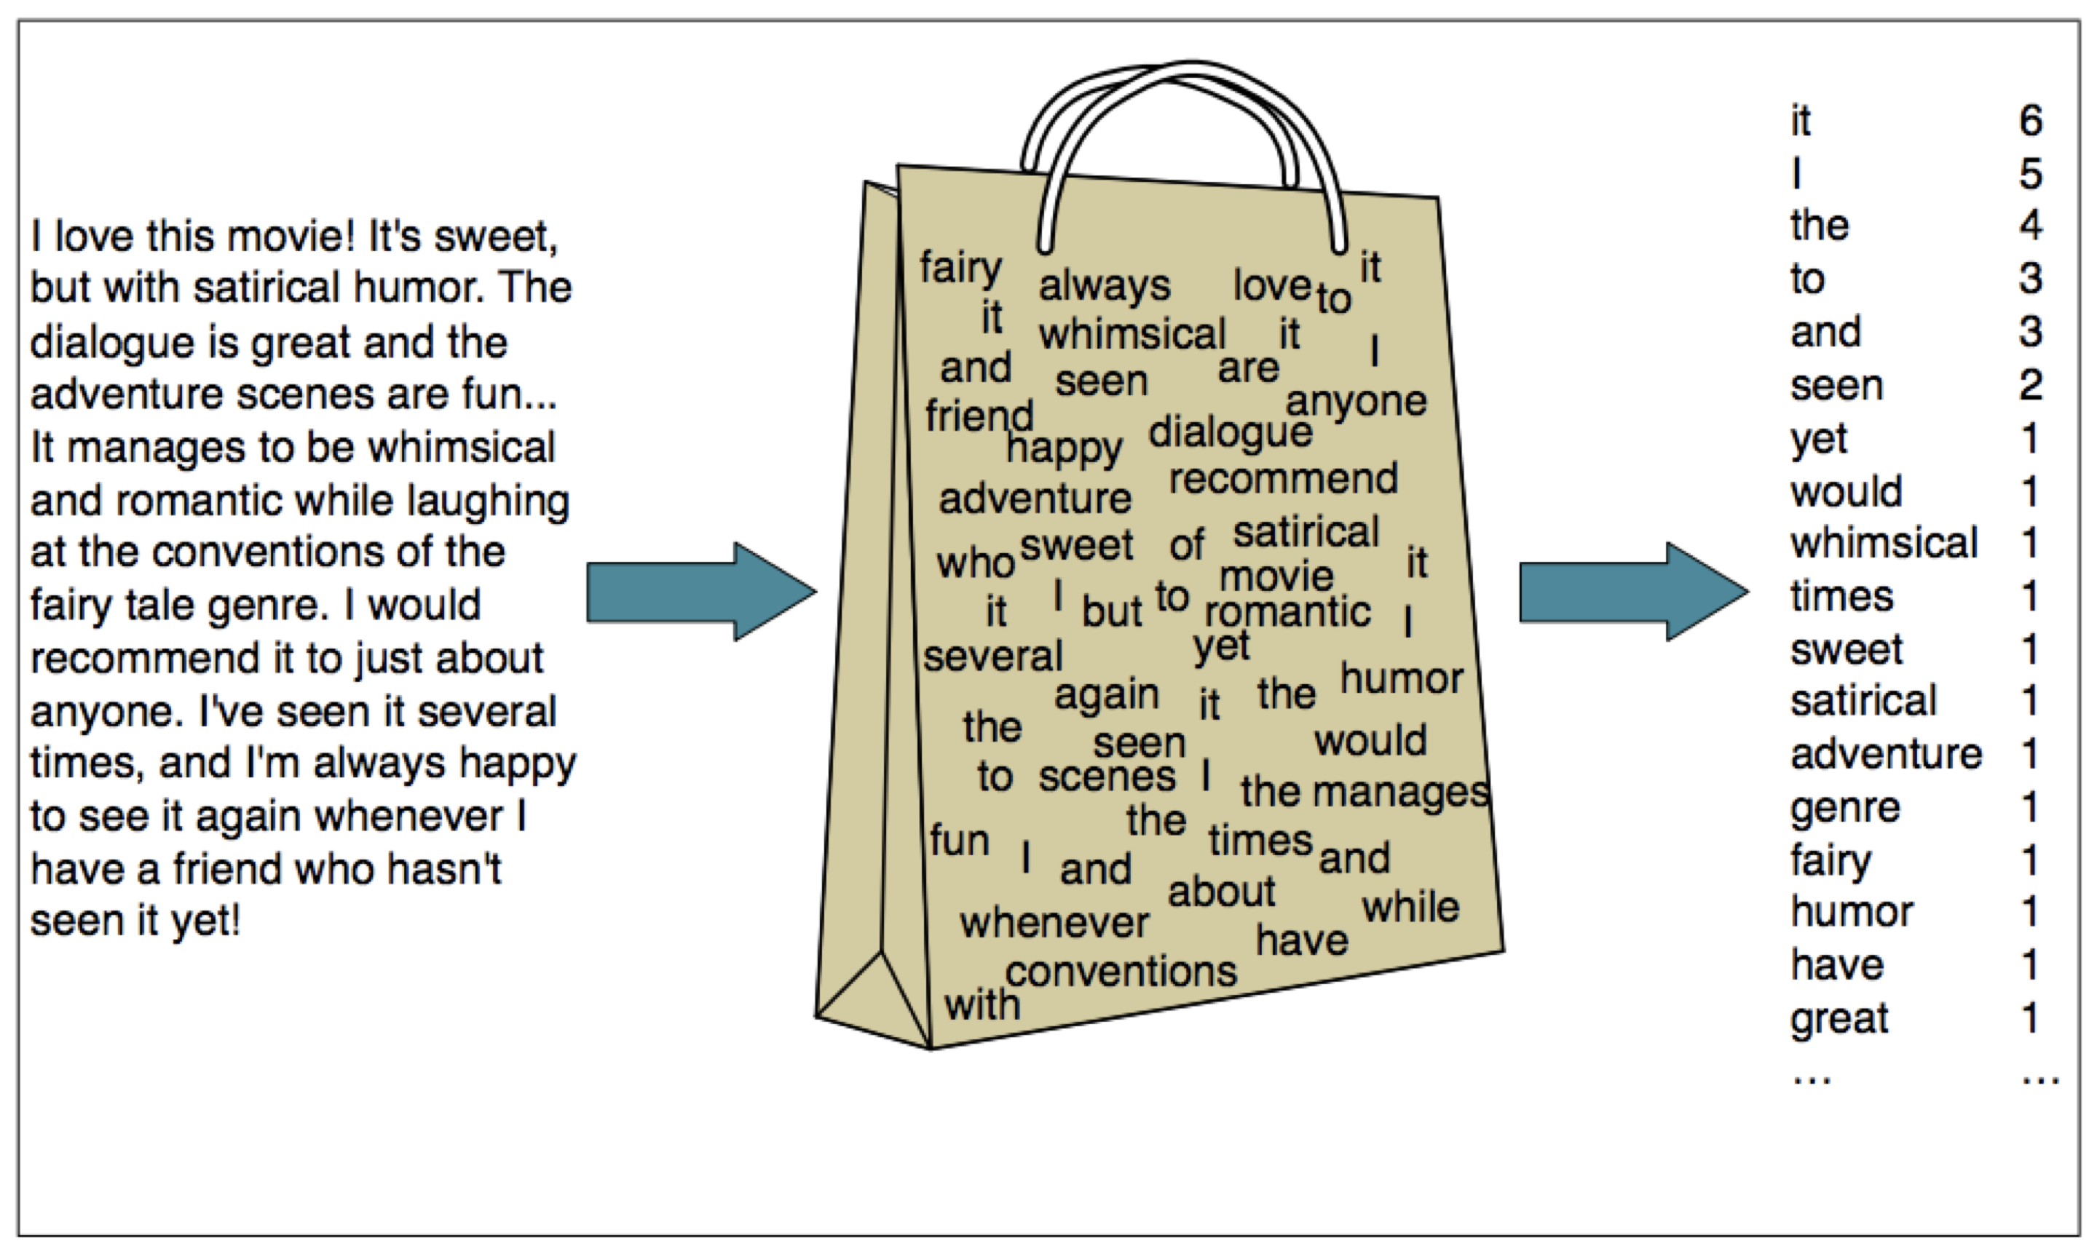
Naïve Bayes

Slide 16
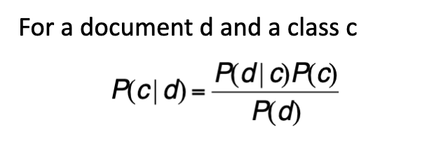
Bayes Rule Applied to Documents

Slide 17

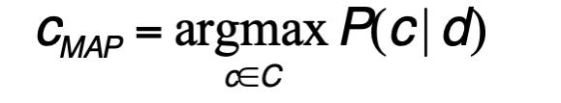
Bayes Rule Applied to Documents

Slide 18
Naïve Bayes Classifier
MAP is “maximum a posteriori” = most likely class
Bayes Rule
Dropping the denominator

Slide 19
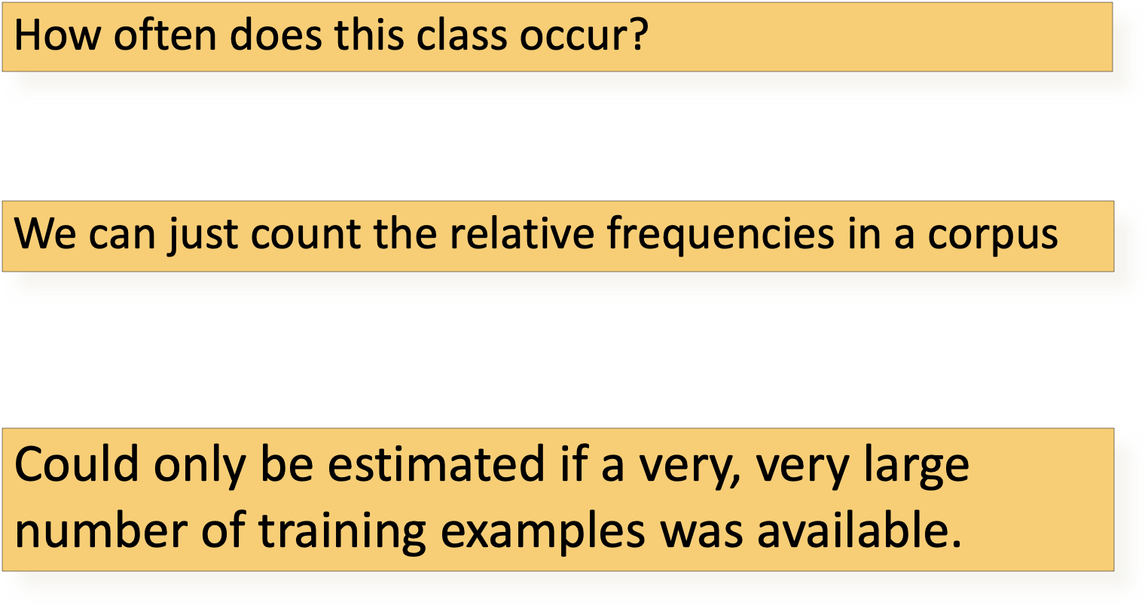
Naïve Bayes Classifier

Slide 20
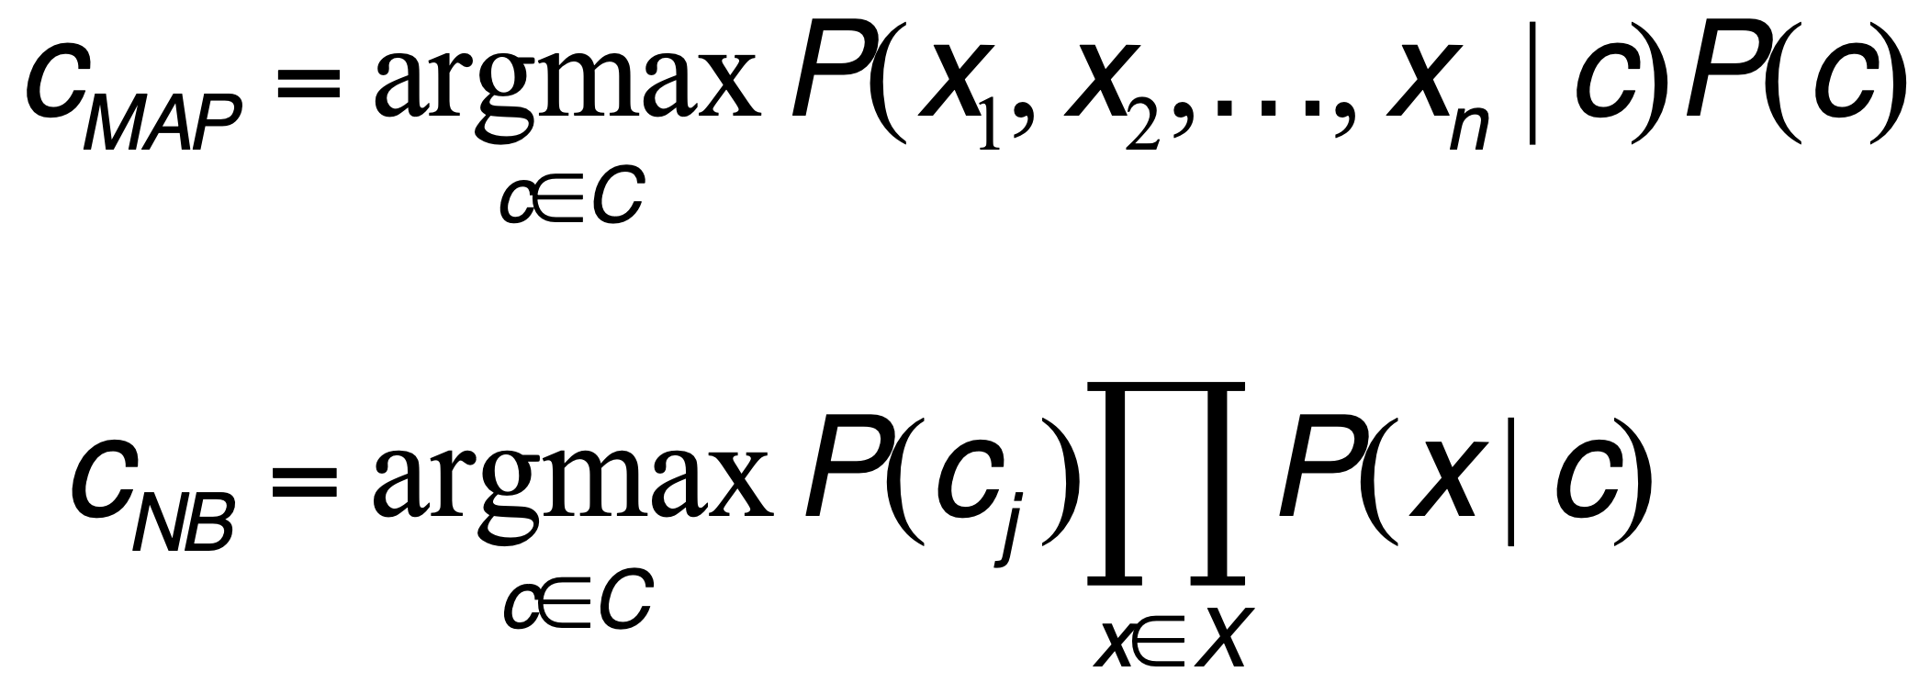
Naïve Bayes Classifier: Independence Assumption
Bag of Words assumption: Assume position doesn’t matter
Conditional Independence: Assume the feature probabilities P(x_{i}|c_{j}) are independent given the class c_{j}.

Slide 21
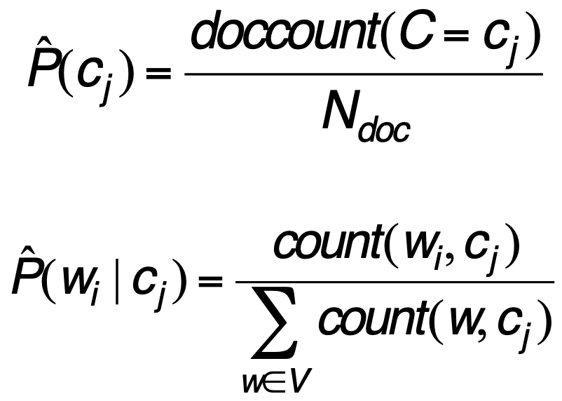
Learning: Naïve Bayes Classifier
First attempt: maximum likelihood estimates
simply use the frequencies in the data

Slide 22
Learning: Naïve Bayes Parameter Estimation
fraction of times word w_{i} appears among all words in documents of topic c_{j}
fraction of word in the full vocabulary that appeared in topic c_{j}

Slide 23
Learning: Naïve Bayes Parameter Estimation
fraction of times word w_{i} appears among all words in documents of topic c_{j}
fraction of word in the full vocabulary that appeared in topic c_{j}
What if we have seen no training documents with the word fantastic in the topic positive?
Zero probabilities cannot be conditioned away

Slide 24
Smoothing: Naïve Bayes Parameter Estimation

Slide 25
Laplace Smoothing: Naïve Bayes Parameter Estimation

Slide 26
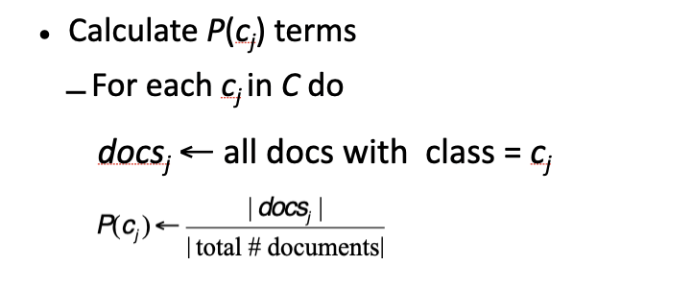
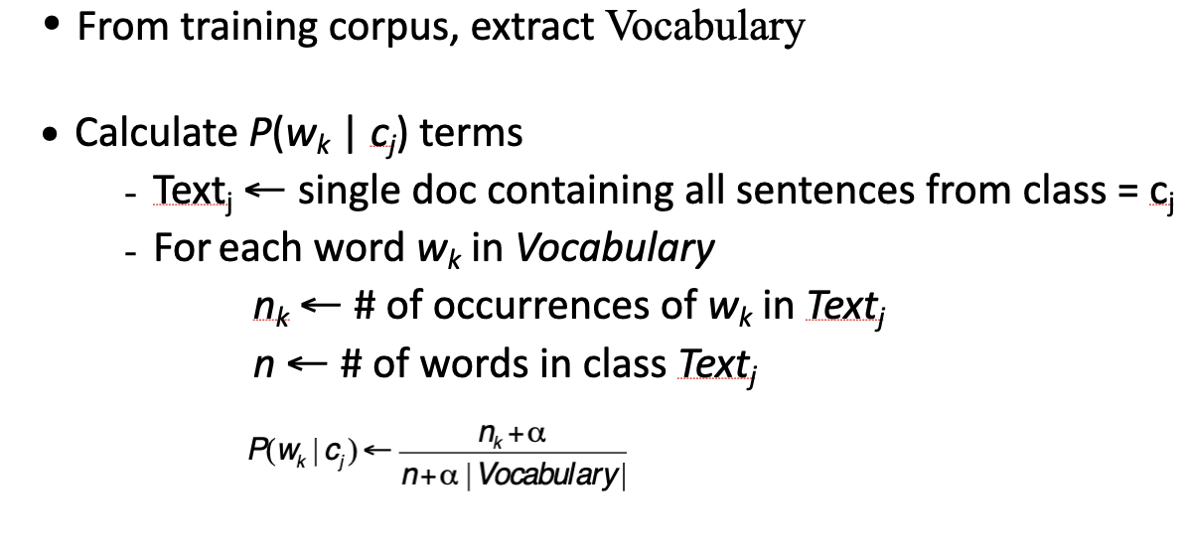
Naïve Bayes Parameter Learning: Step

Slide 27
In Class Exercise

Slide 28
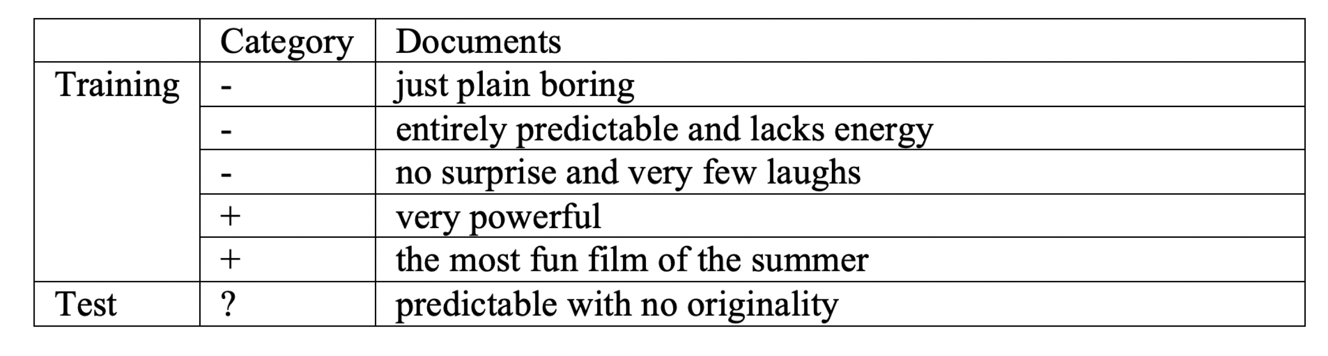
What will be category of the test data?

Slide 29
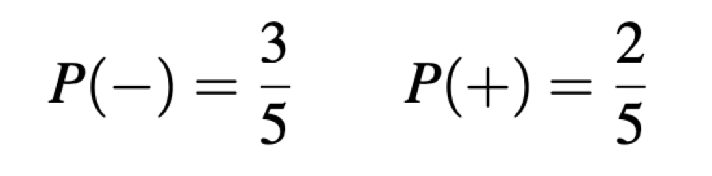
What will be category of the test data?

Slide 30
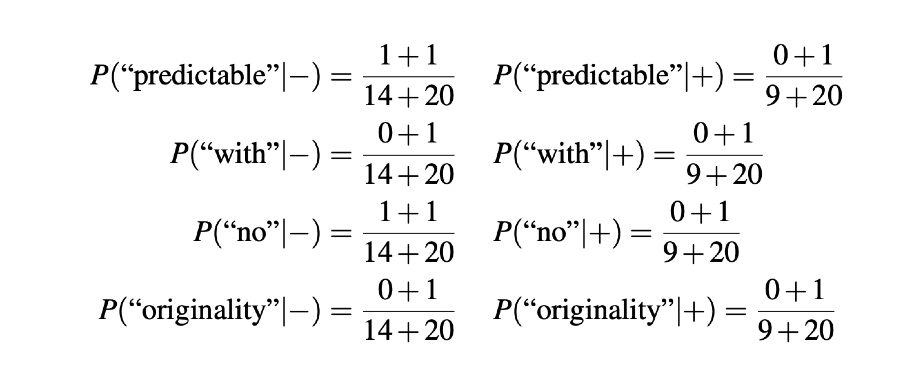
What will be category of the test data?

Slide 31
What will be category of the test data?

Slide 32
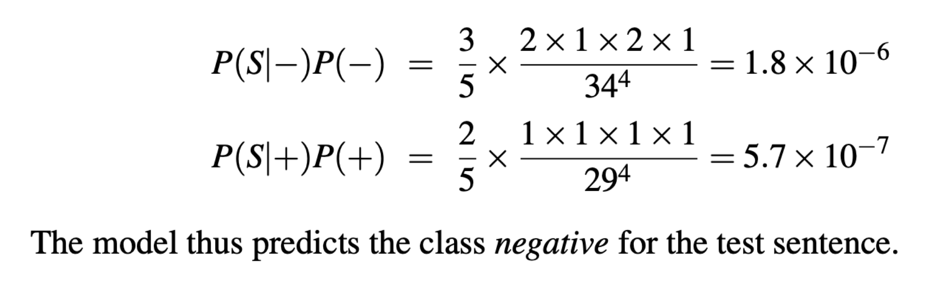
What will be category of the test data?

